Slide 2
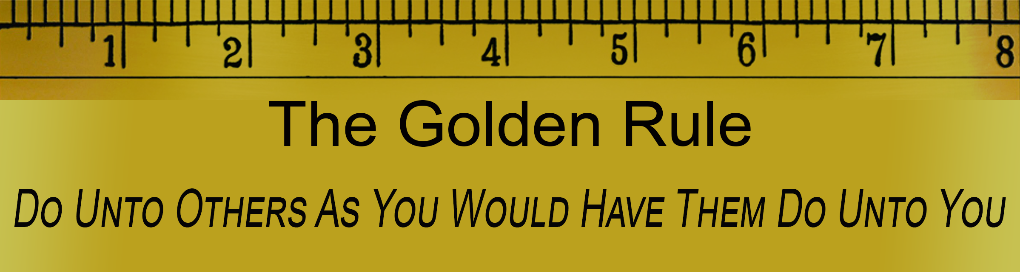
Sermon on the Mount
Matthew 5-7
“The Golden Rule”
The Basic Rule Toward Others
Matthew 7:12

Slide 3
Sermon
on
the Mount
GOLDEN VS SILVER RULE
Many Taught That Which Is Similar
Hindu: “This is the sum of duty: do naught to others which if done to thee would cause thee pain.” The Mahabharata
Buddhist: “Hurt not others with that which pains yourself” Udana-Varga
Jewish: “What is hateful to you, do not to your fellow men. That is the entire Law; all the rest is commentary.” The Talmud
Muslim: “No one of you is a believer until he desires for his brother that which he desires for himself.”

Slide 4
Sermon
on
the Mount
GOLDEN VS SILVER RULE
Baha’i Faith: “He should not wish for others that which he doth not wish for himself, nor promise that which he doth not fulfill.” Book of Certitude
Pittacus of Lesbos (650-570 BC) “Do not that to thy neighbor that thou wouldst not suffer from him”
Confucius (551-479 BC) “What you do not want others to do to you, do not do to others”
Isocrates (436-338 BC) “Do not do unto others what angers you if done to you by others.”
Seneca (4 BC-AD 65) “Treat your inferiors as you would be treated by your betters.”

Slide 5
Sermon
on
the Mount
JESUS’ “RULE” WAS SLIGHTLY DIFFERENT
Jesus: “Do unto others what you want them to do to you.”
Others: “Don’t do to others what you don’t want done to you.”
With Others: All that is required is that you don’t harm other people
With Jesus: What is required is that you show kindness to others

Slide 6

Sermon
on
the Mount
Hadith: traditions of Islam; but then, much of Islam is based upon what Jesus taught 600 years before Mohammed
Seneca: who lived about the same time as Christ
What Jesus taught was something NEW compared to what uninspired teachers had taught prior
But in another sense it was nothing new!

Slide 7
Sermon
on
the Mount
A GUIDLINE FOR RIGHTEOUS CONDUCT TOWARD OTHERS
In Harmony With The Law & The Prophets
Evident in Matthew 5:20-48
A standard or righteousness that contrasted that of the scribes & Pharisees
It was in harmony with what Law revealed
Summarizes what Law & Prophets all about
Romans 13:8-10 "You shall love your neighbor as yourself."

Slide 8
Sermon
on
the Mount
A SORT OF “POCKET KNIFE” OR “CARPENTER’S RULE”
Something always ready to be used
Even in an emergency!
No time to consult a friend, teacher, or book
The “Golden Rule” can be a guide for proper conduct
Treat others as you would be treated, and it is unlikely you will ever do the wrong thing!

Slide 9
Sermon
on
the Mount
EXAMPLES OF HOW TO APPLY THIS RULE
In Teaching The Lost
Wouldn’t you want to be told so in a loving & patient spirit?
As you would have others try to persuade you to change religiously, so treat those you seek to convert
2 Timothy 2:24-26 “in humility correcting those who are in opposition”
Ephesians 4:15 “speaking the truth in love, may grow up in all things into Him who is the head--Christ–”

Slide 10
Sermon
on
the Mount
EXAMPLES OF HOW TO APPLY THIS RULE
In Correcting One Another
No one likes to have their mistakes pointed out
Wouldn’t we prefer to be approached with a meek and patient spirit?
As you would have others offer you constructive criticism, so give it to them
Galatians 6:1,2 “…you who are spiritual restore such a one in a spirit of gentleness, considering yourself lest you also be tempted.”

Slide 11
Sermon
on
the Mount
EXAMPLES OF HOW TO APPLY THIS RULE
In Treating Our Family, Neighbors, Enemies…
Everyone likes loving families, good neighbors, no enemies
Applying the rule will not only transform ourselves, but may all transform those around us!
Sibling rivalry would cease
Neighborly squabbles would be nonexistent
Enemies would become friends
Don’t limit application to religious matters!

Slide 12
Sermon
on
the Mount
“The Golden Rule Would Reconcile Capital And Labor, All Political Contention and Uproar, All Selfishness and Greed.”
Joseph Parker (1830-1902)
“We have committed the Golden Rule to memory; let us now commit it to life.” Edwin Markham (1852-1940)
IF Jesus is truly our Lord – His “Golden Rule” Will Govern Our Life!

